Slide 1
The Phillips Collection

Slide 2

Mission
Statement.
The Phillips Collection is America’s first home for modern and contemporary art, where the intimate and experimental meet. Through art, every visitor can explore the most pressing ideas of our time via dynamic collaborations, innovative inquiry, empathetic forms of public participation, and diverse voices.

Slide 3

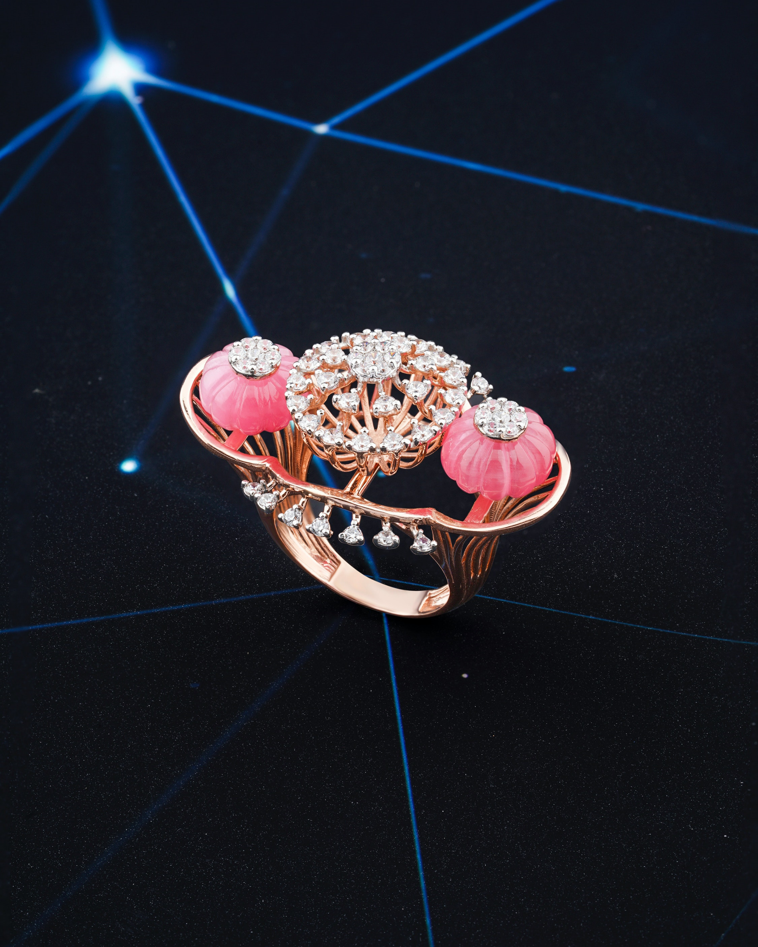
Audience
The Phillips Collection galleries are frequently rearranged to facilitate new conversations between artworks and fresh experiences for visitors.
In addition to presenting selections from the permanent collection and special exhibitions, The Phillips Collection also offers award-winning education and community engagement programs for audiences of all ages and backgrounds, including initiatives at its satellite campus Phillips@THEARC.
The Phillips Collection is a private, non-government museum, supported primarily by donations.

Slide 4

Vision .
The Phillips Collection’s vision is to give voice to the powerful artistic expressions of diverse people, with empathy and inclusion, and to connect with the relevant ideas of our time.
CEO: Jonathan P. Binstock, Vradenburg
Founder: Duncan Phillips

Slide 5
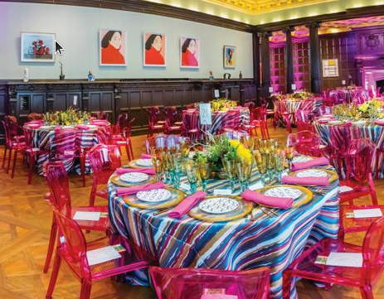
History.
Duncan Phillips (1886-1966), the son of Major Duncan Clinch Phillips, a Pittsburgh businessman, and Eliza Laughlin Phillips, co-founder of Jones and Laughlin Steel Company, was deeply passionate about art. Moving to Washington, DC, in 1895, Duncan, alongside his brother Jim, attended Yale University together. In 1914, they moved to New York, where Duncan published his first book, "The Enchantment of Art." Tragedy struck in 1917 and 1918, with the sudden deaths of their father and Jim. To cope, Duncan turned to art, founding the Phillips Memorial Art Gallery in 1918. Originally housed in their family home, the collection expanded, prompting a move in 1930 to a dedicated museum space, emphasizing Duncan's vision of uniting past and present art in the nation's capital.

Slide 6



Current Branding
Current Branding Include Text based logo. The elements are simple vector art containing mixture of colors. Each color represent the brand. There are basically four colors in logo which are also seen on website elements
Website
Social Media
History
Contains SImple Logo that is enriched with different colors and represent the brand
Social Media branding also contains same set of elements but color vary in logo and posts
Past Branding are slightly different but the logo elements are same textual elements

Slide 7

Thank You !

